Slide 1
Semantics Project Group 3
David Carrascosa
Albert Baito
Pablo Alfaro
Camilo Mercado
Andrea Bellini

Slide 2
Steps
Step 1
Step 2
Step 3
Choose Recipe
Annotate Recipe RDFA HTML
Translate to TTL
Step 4
Query Creation

Slide 3
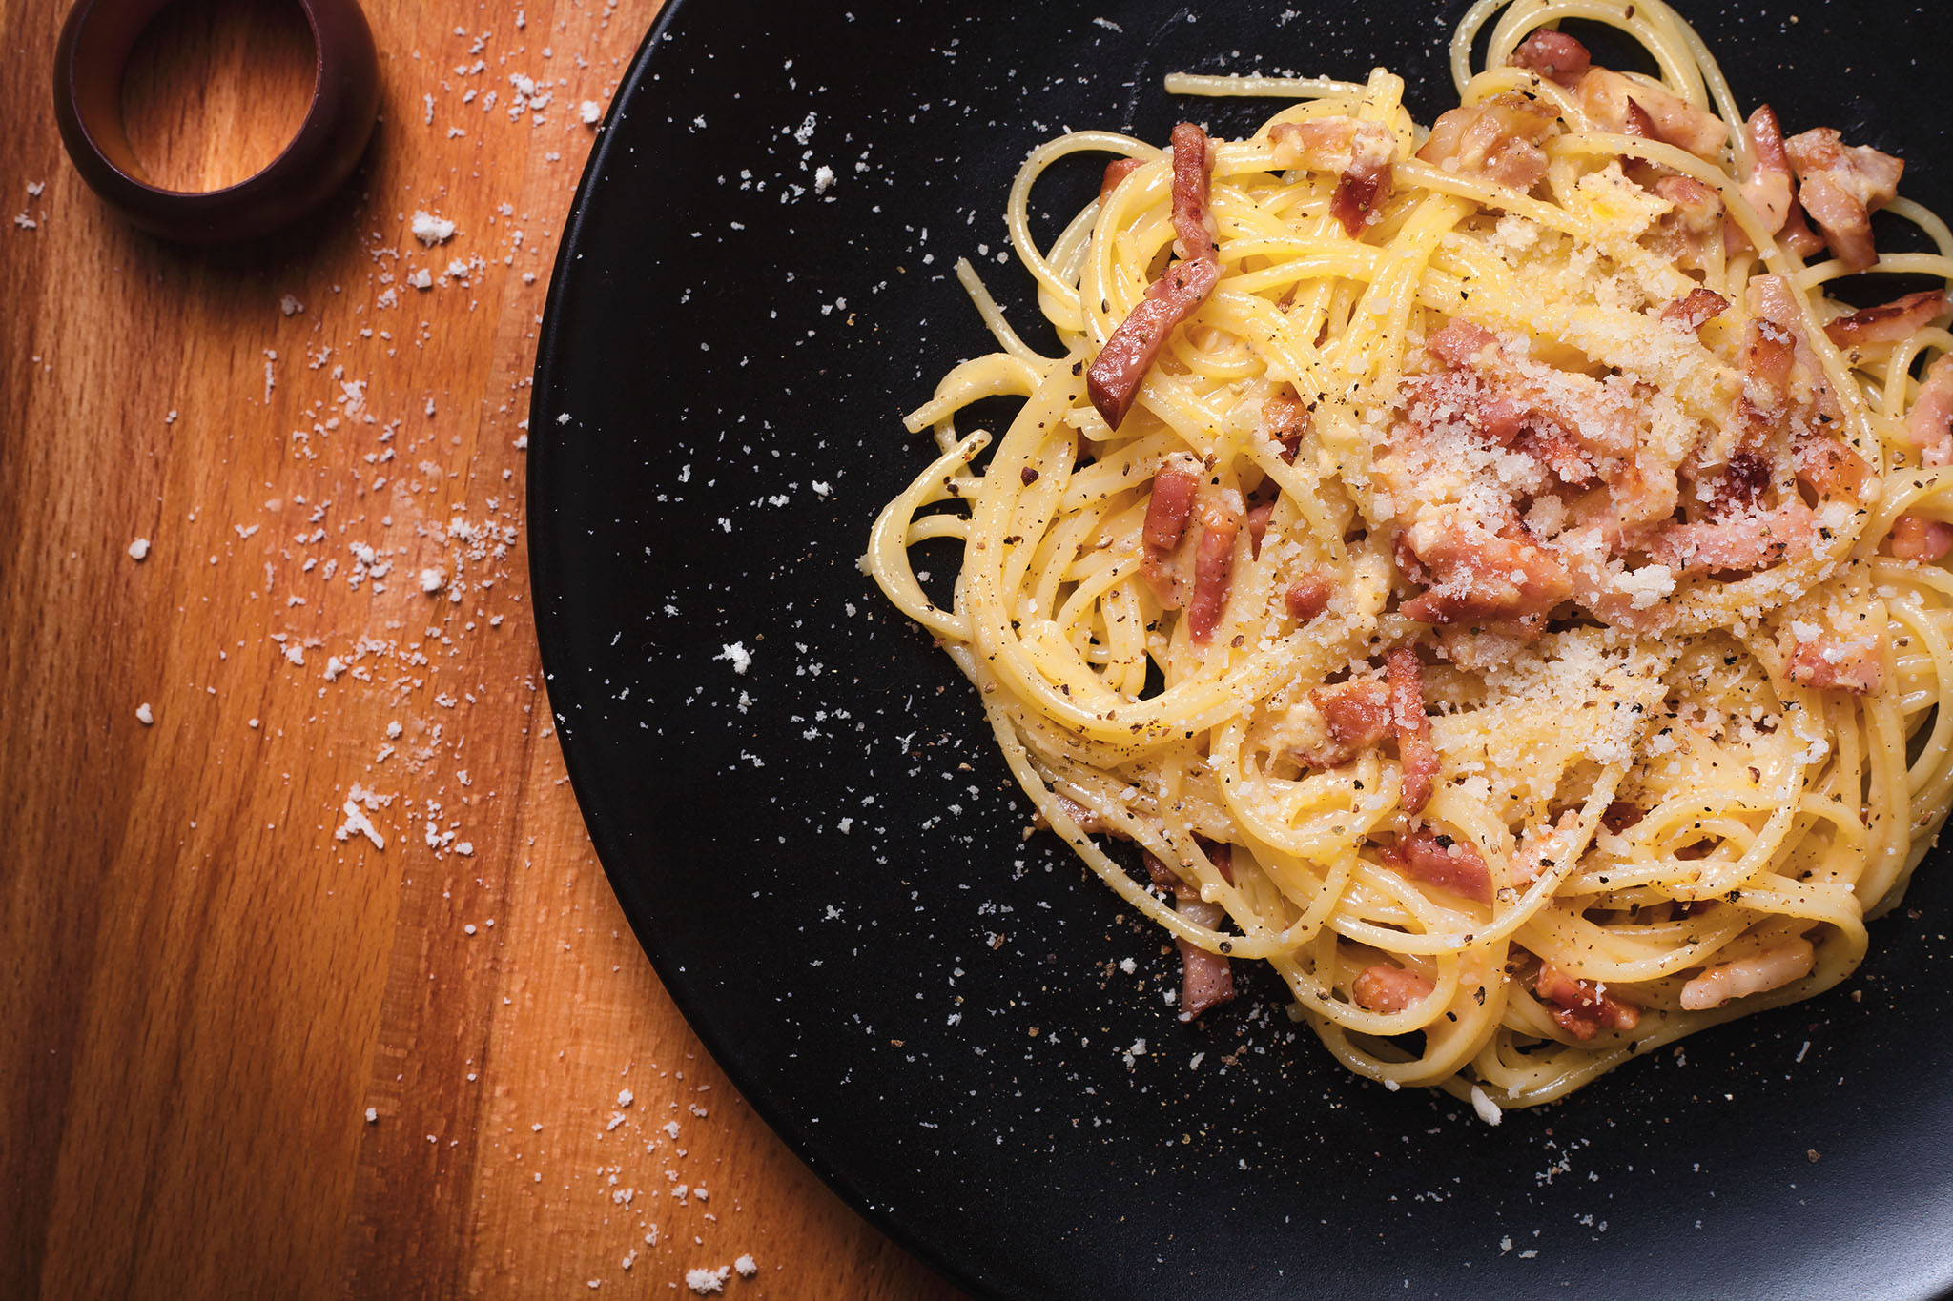
Step 1: Recipe
Spaghetti Carbonara

Slide 4
HTML Annotation
Description:
Author: Emanuele Rossi
Date Published: June 1, 2025
Description: "A classic Italian pasta dish made with eggs, cheese, pancetta, and pepper."
Key Words: "pasta, carbonara, Italian"
Prep Time: 10 minutes
Cook Time: 15 minutes
Nutrition: 550 calories
Rating: 4.8 / 5 (125 reviews)
Ingredients:
200 g Spaghetti
100 g pancetta
2 large eggs
50 g pecorino cheese
Freshly ground black pepper
Salt
Instructions
Bring a large pot of salted water to a boil and cook spaghetti until al dente.
In a bowl, beat eggs and mix in grated pecorino cheese.
In a pan over medium heat, cook pancetta until crisp.
Drain pasta (reserving some cooking water) and add it to the pan with pancetta.
Remove pan from heat; pour egg–cheese mixture over pasta, stirring quickly to create a creamy sauce. If needed, add a tablespoon of pasta water.
Season generously with freshly ground black pepper and serve immediately.

Slide 5
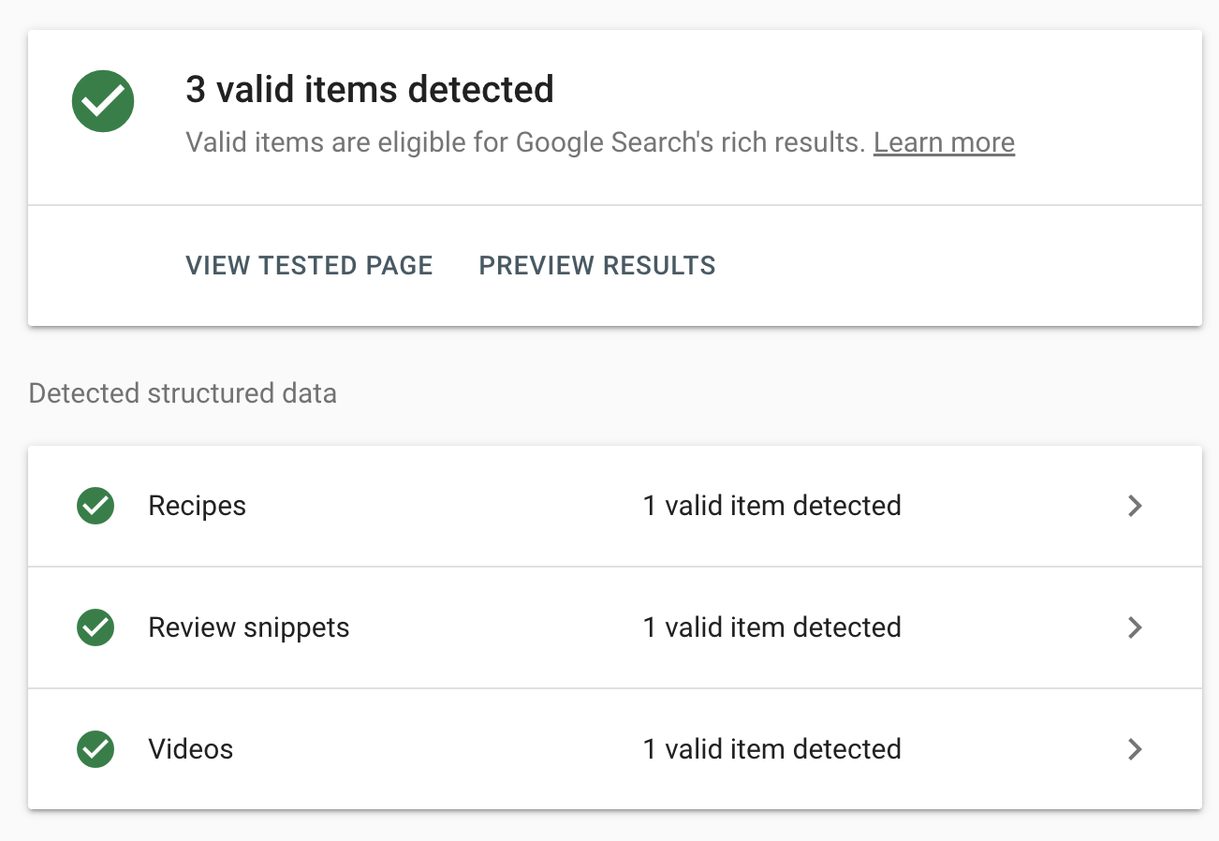

Slide 6
RDF Conversion
HTML (RDFa Embedded) | RDF Turtle Output
<h1 property="name">Spaghetti Carbonara</h1> | schema:name "Spaghetti Carbonara"@en ;
<span property="author" typeof="Person"><span property="name">Emanuele Rossi</span></span> | schema:author [ a schema:Person ; schema:name "Emanuele Rossi"@en ] ;
<time property="datePublished" content="2025-06-01">June 1, 2025</time> | schema:datePublished "2025-06-01"^^xsd:date ;
<li property="recipeIngredient">200 g spaghetti</li> | schema:recipeIngredient "200 g spaghetti"@en ;
Using EasyRDF, we extracted structured data from an HTML page containing a recipe and transformed it into RDF Turtle format using the Schema.org vocabulary.

Slide 7
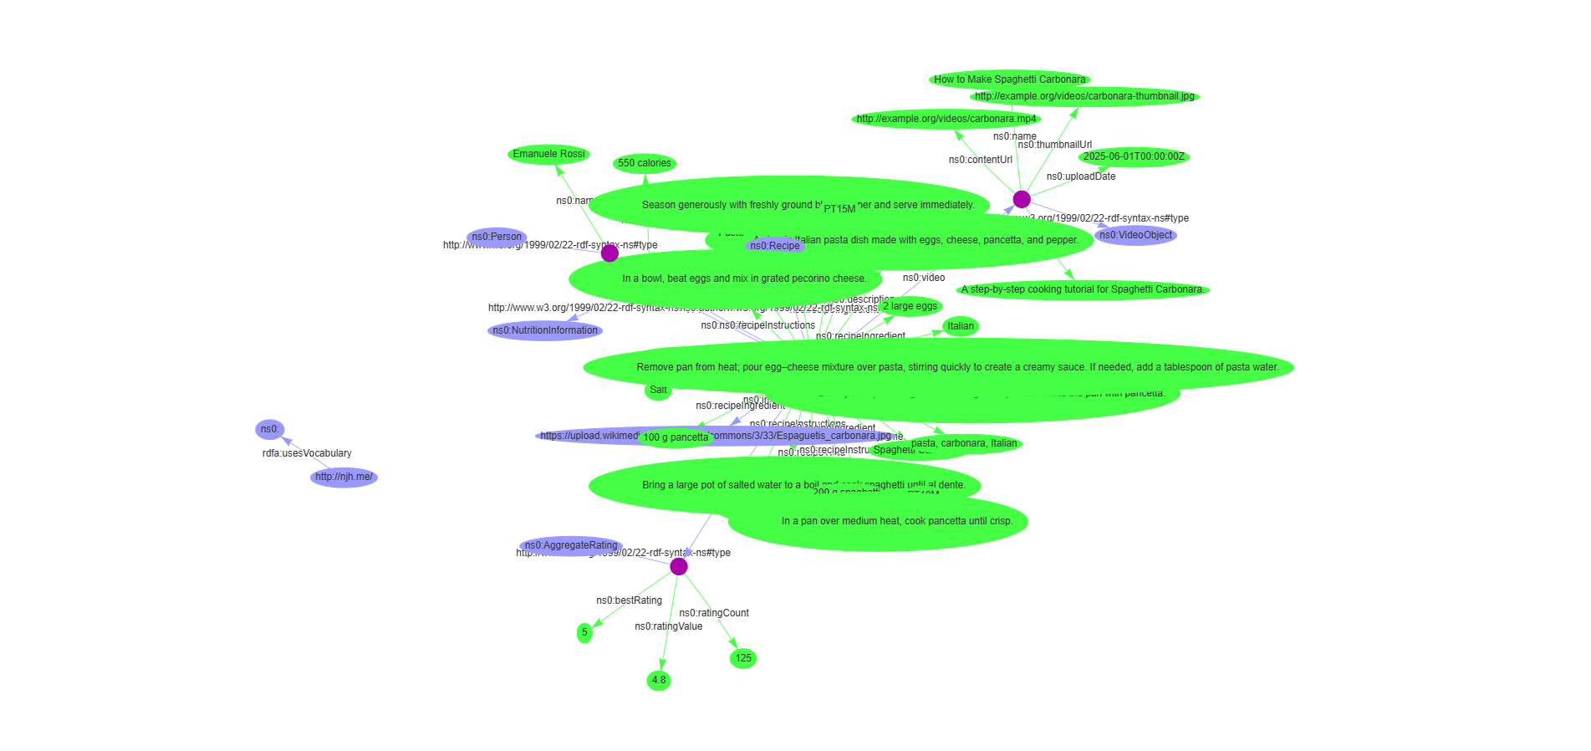
Graph

Slide 8
Queries on SPARQL

Slide 9
Show recipe
PREFIX ns0: <https://schema.org/>
PREFIX xsd: <http://www.w3.org/2001/XMLSchema#>
SELECT ?recipe
WHERE {
?recipe a ns0:Recipe .
}
-----------------------------------------
| recipe |
=========================================
| <http://example.org/recipe/carbonara> |
-----------------------------------------

Slide 10
Recipe’s name, author, image
PREFIX ns0: <https://schema.org/>
PREFIX xsd: <http://www.w3.org/2001/XMLSchema#>
SELECT ?recipe ?title ?authorName ?img
WHERE {
?recipe a ns0:Recipe .
?recipe ns0:name ?title .
?recipe ns0:author ?person .
?person ns0:name ?authorName .
?recipe ns0:image ?img .
}
---------------------------------------------------------------------------------------------------------------------------------------------------------------------------
| recipe | title | authorName | img |
===========================================================================================================================================================================
| <http://example.org/recipe/carbonara> | "Spaghetti Carbonara"@en | "Emanuele Rossi"@en | <https://upload.wikimedia.org/wikipedia/commons/3/33/Espaguetis_carbonara.jpg> |
---------------------------------------------------------------------------------------------------------------------------------------------------------------------------

Slide 11
Does the recipe include eggs
PREFIX ns0: <https://schema.org/>
PREFIX xsd: <http://www.w3.org/2001/XMLSchema#>
ASK
WHERE {
?recipe a ns0:Recipe .
?recipe ns0:recipeIngredient ?ing .
filter contains(lcase(?ing), 'egg')
}
yes

Slide 12
Is the recipe’s caloreies above 600?
Query:
PREFIX ns0: <https://schema.org/>
PREFIX xsd: <http://www.w3.org/2001/XMLSchema#>
ASK
WHERE {
?rcp a ns0:Recipe ;
ns0:name ?name ;
ns0:nutrition ?nutrition .
?nutrition ns0:calories ?cal
BIND(xsd:integer(substr(?cal, 1, 3)) AS ?calories)
FILTER(?calories > 600)
}
no

Slide 13
Count how many ingredients each recipe has
SELECT ?recipe (COUNT(?ing) AS ?ingredientCount)
WHERE {
?recipe a ns0:Recipe .
?recipe ns0:recipeIngredient ?ing .
}
GROUP BY ?recipe
-----------------------------------------------------------
| recipe | ingredientCount |
===========================================================
| <http://example.org/recipe/carbonara> | 6 |
-----------------------------------------------------------

Slide 14
Show recipe along with their calorie count
SELECT ?recipe ?title ?cal
WHERE {
?recipe a ns0:Recipe .
?recipe ns0:name ?title .
OPTIONAL {
?recipe ns0:nutrition ?nut .
?nut ns0:calories ?cal .
}
}
----------------------------------------------------------------------------------------
| recipe | title | cal |
========================================================================================
| <http://example.org/recipe/carbonara> | "Spaghetti Carbonara"@en | "550 calories"@en |
----------------------------------------------------------------------------------------

Slide 15
Does the recipe belong to category Pasta or Italian?
ASK
WHERE {
?recipe a ns0:Recipe .
{
?recipe ns0:recipeCategory "Pasta"@en .
}
UNION
{
?recipe ns0:recipeCuisine "Italian"@en .
}
}
yes

